Slide 1
Lecture 3 Overview of Machine Learning and AI

Slide 3
AI and the Machine Learning Approaches
ML problem types
Based on data:
Supervised, Unsupervised, Semi-supervised
2. Based on output
Regression, Classification
3. Based on models
Generative, Discriminative

Slide 4
Most widely used methods of ML, e.g.,
Spam classification of email
Face recognition over images
Disease diagnosis and prediction
Input are vectors or more complex objects
Outputs are binary, multi

Slide 5
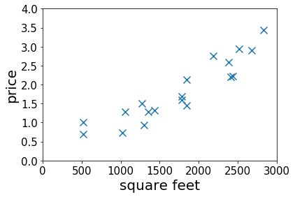
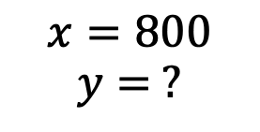
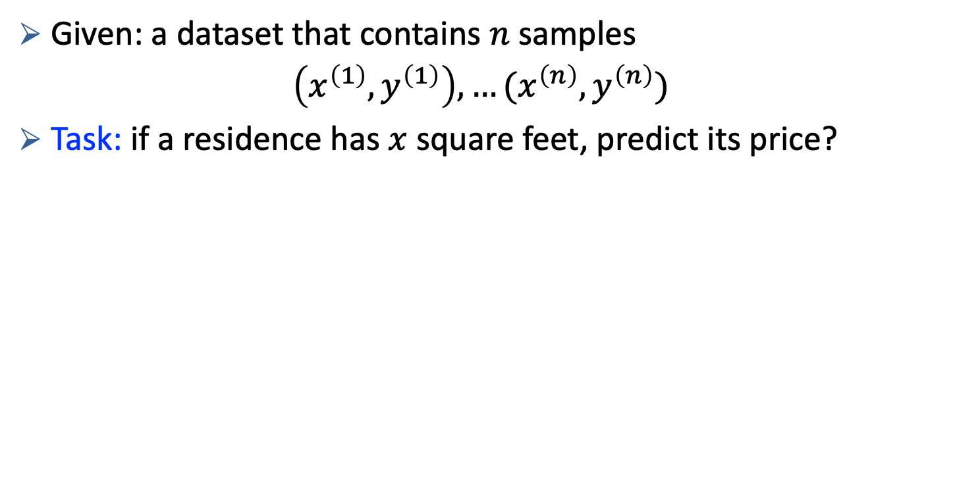
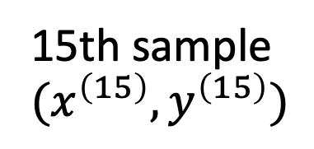
Given: a dataset that contains $n$ samples
$\left(x^{\left(1\right)},y^{\left(1\right)}\right), …(x^{\left(n\right)},y^{\left(n\right)})$
Task: if a residence has $x$ square feet, predict its price?
15th sample $(x^{\left(15\right)},y^{\left(15\right)})$
$$x=800$$
$$y= ?$$

Slide 6
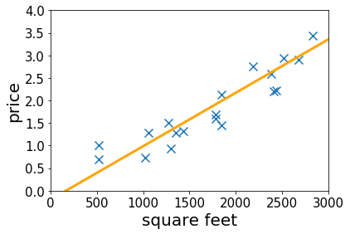
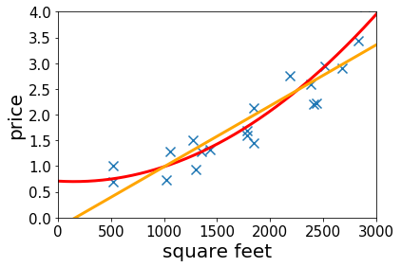
Given: a dataset that contains $n$ samples
$\left(x^{\left(1\right)},y^{\left(1\right)}\right), …(x^{\left(n\right)},y^{\left(n\right)})$
Task: if a residence has $x$ square feet, predict its price?
$$x=800$$
$$y= ?$$
Lecture 2&3: fitting linear/qaudratic functions to the dataset

Slide 7
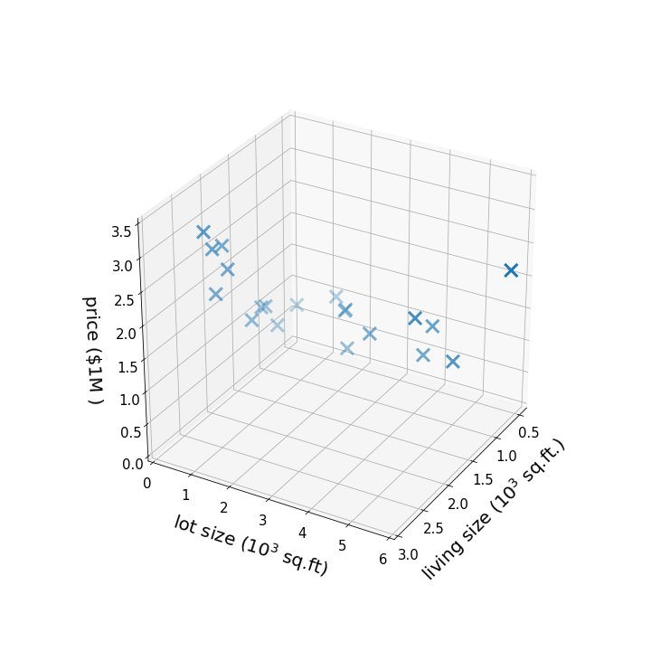
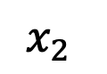
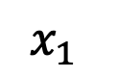
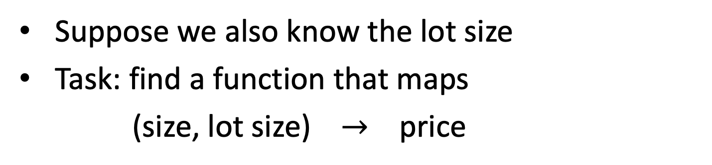
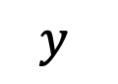
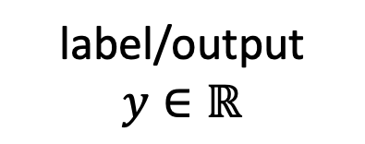
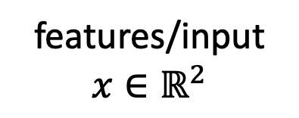
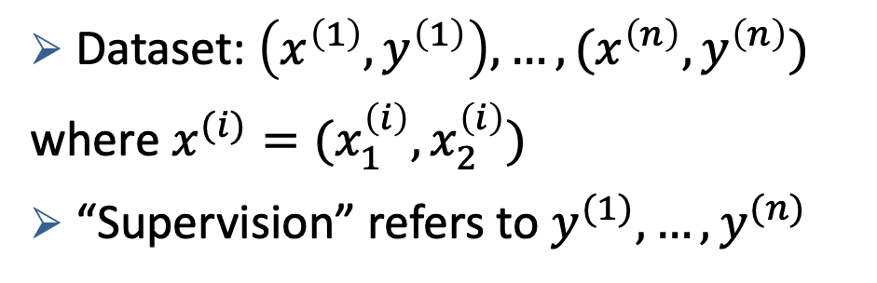
If there are more features…
Suppose we also know the lot size
Task: find a function that maps
(size, lot size) $→$ price
$$y$$
features/input
$$x∈ℝ^{2}$$
label/output
$$y∈ℝ$$
Dataset: $\left(x^{\left(1\right)},y^{\left(1\right)}\right), …,(x^{\left(n\right)},y^{\left(n\right)})$
where $x^{(i)}=(x_{1}^{\left(i\right)},x_{2}^{\left(i\right)})$
“Supervision” refers to $y^{(1)},…, y^{(n)}$
$$x_{2}$$
$$x_{1}$$

Slide 8
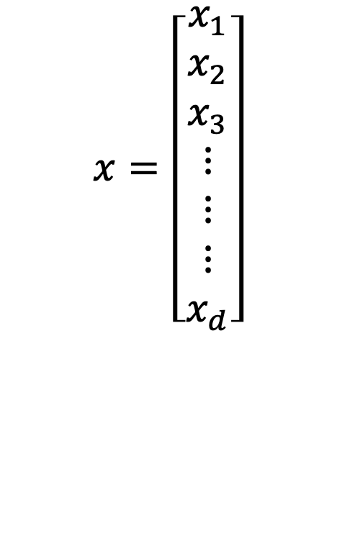
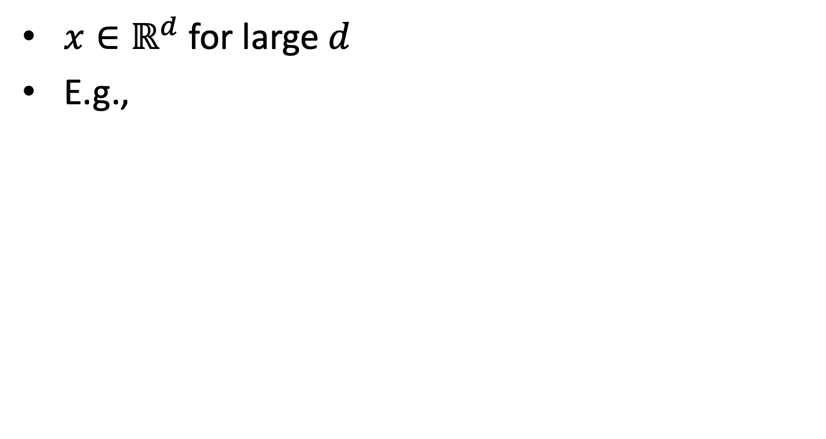

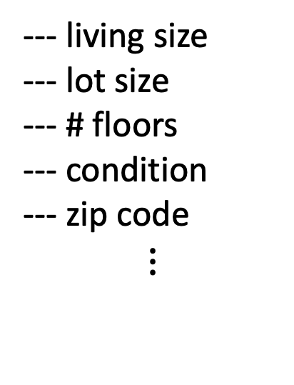
High-dimensional features
$x∈ℝ^{d}$ for large $d$
E.g.,
--- living size
--- lot size
--- # floors
--- condition
--- zip code
$$⋮$$
$$x=\left[\begin{aligned}x_{1} \\ x_{2} \\ x_{3} \\ ⋮ \\ ⋮ \\ ⋮ \\ x_{d}\end{aligned}\right]$$
--- price
$$y$$
Lecture 6-7: infinite dimensional features
Lecture 10-11: select features based on the data

Slide 9
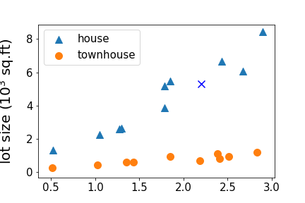
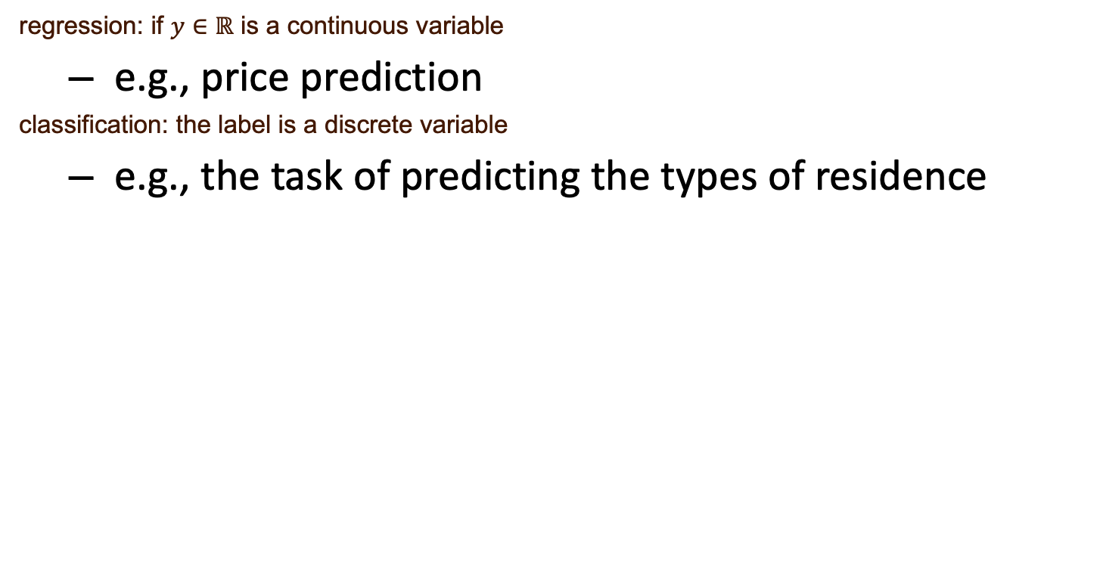
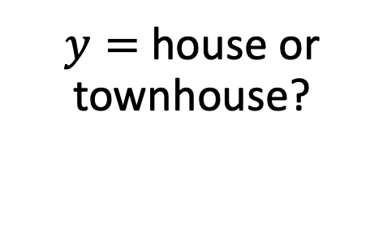
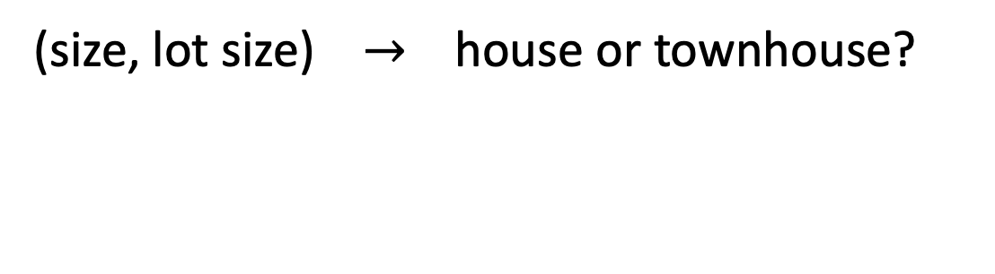
regression: if $y∈ℝ$ is a continuous variable
e.g., price prediction
classification: the label is a discrete variable
e.g., the task of predicting the types of residence
(size, lot size) $→$ house or townhouse?
$y=$ house or townhouse?
Lecture 3&4: classification

Slide 10
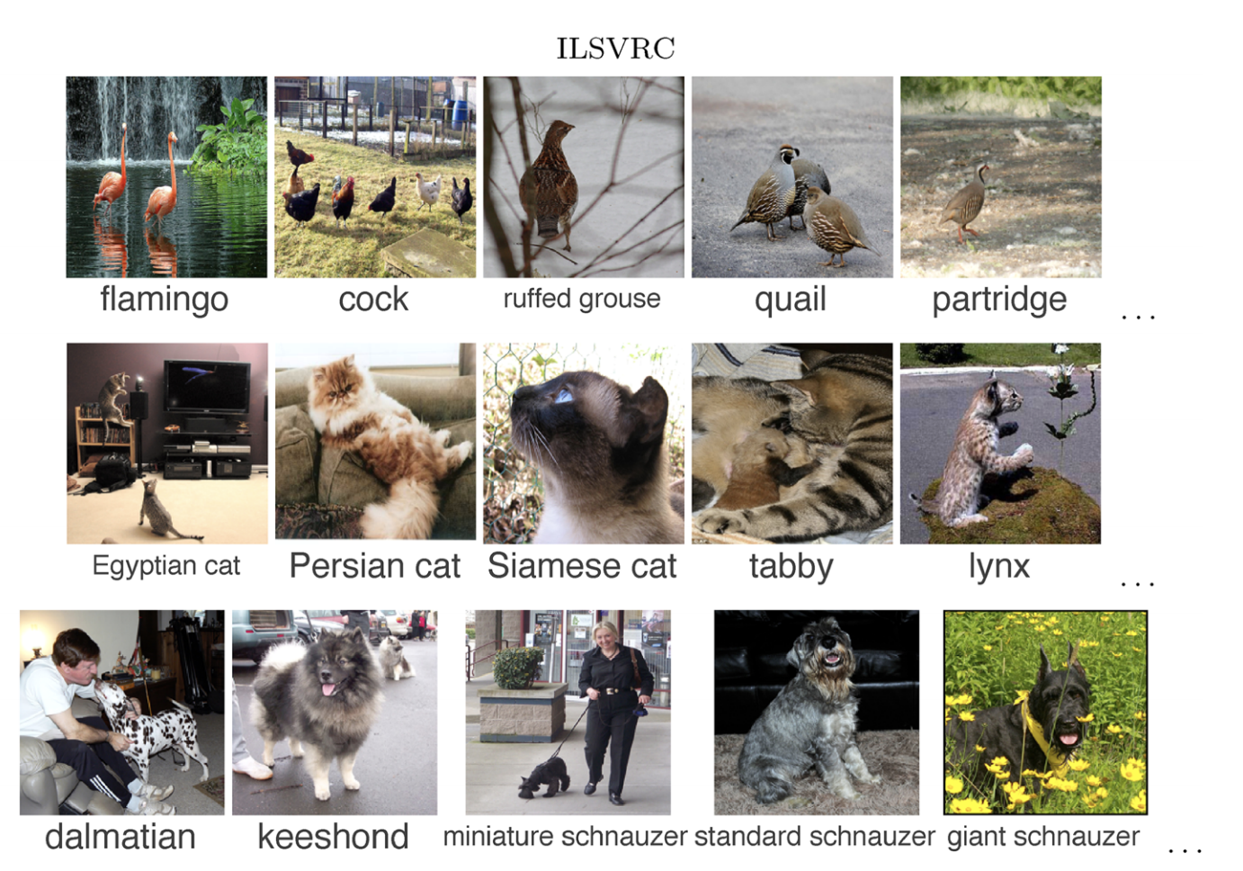
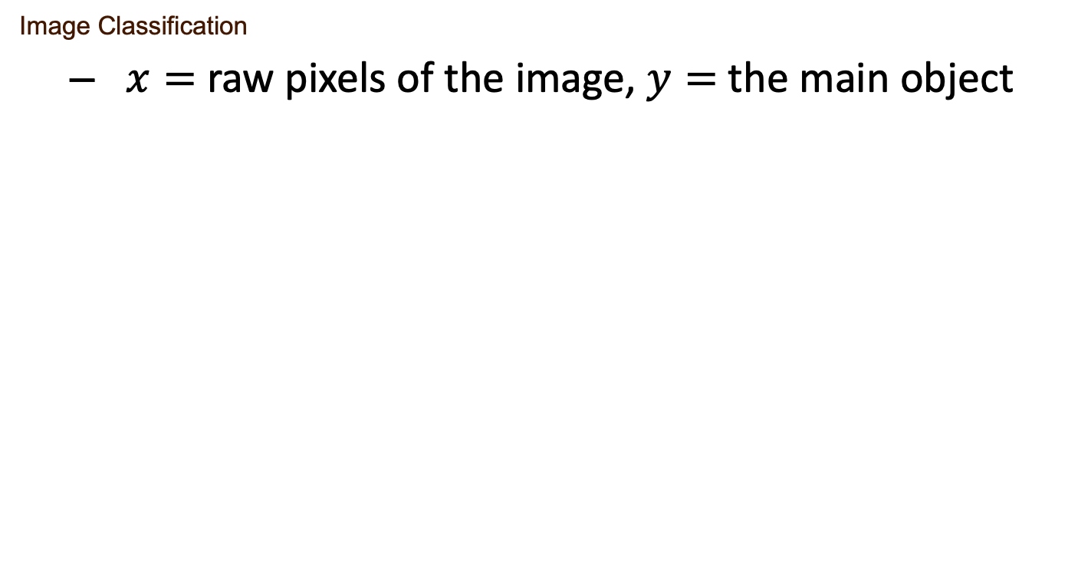
Image Classification
$x=$ raw pixels of the image, $y=$ the main object
ImageNet Large Scale Visual Recognition Challenge. Russakovsky et al.’2015

Slide 12
Unlabeled data assuming underlying structure
Identify a low-dimensional feature space
PCA
Autoencoder
ICA
Clustering

Slide 13

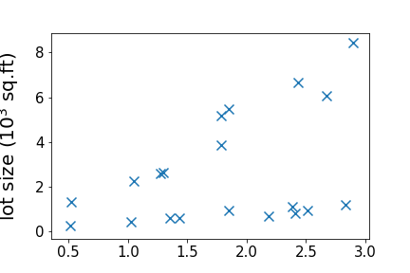
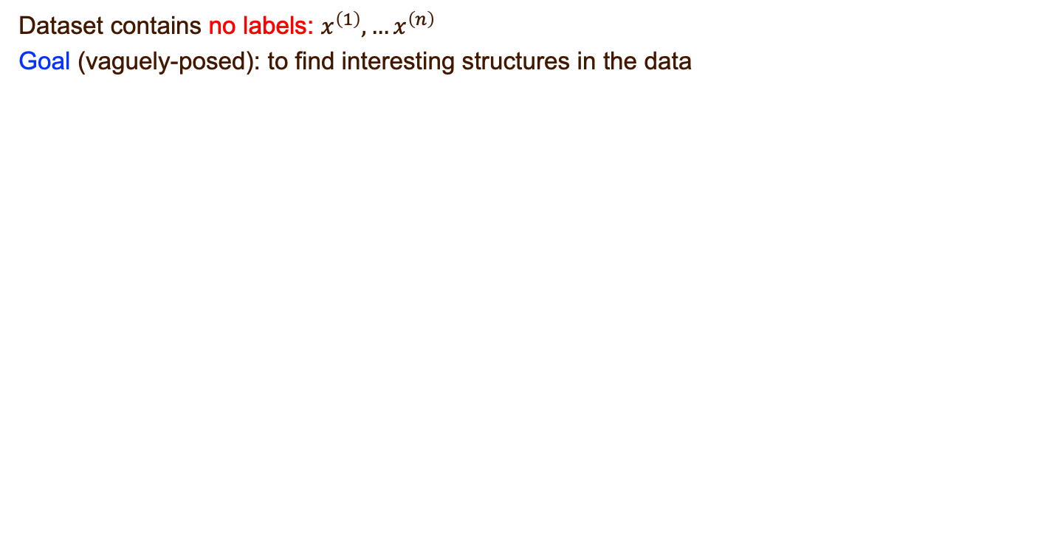
Dataset contains no labels: $x^{\left(1\right)}, …x^{\left(n\right)}$
Goal (vaguely-posed): to find interesting structures in the data
supervised
unsupervised

Slide 14
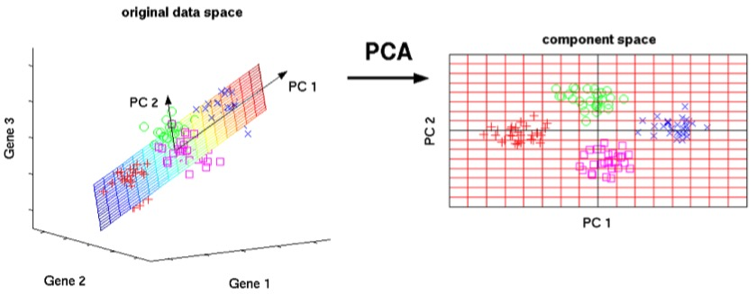
Principal component analysis (PCA)

Slide 15
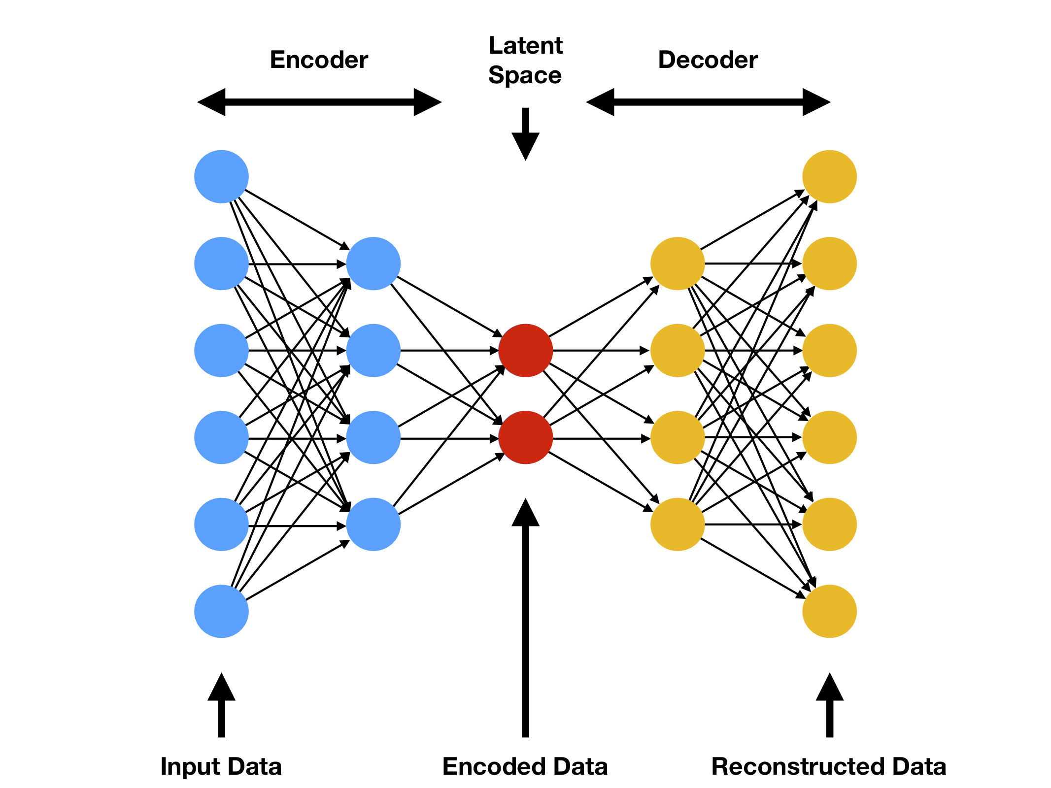
Autoencoder

Slide 17
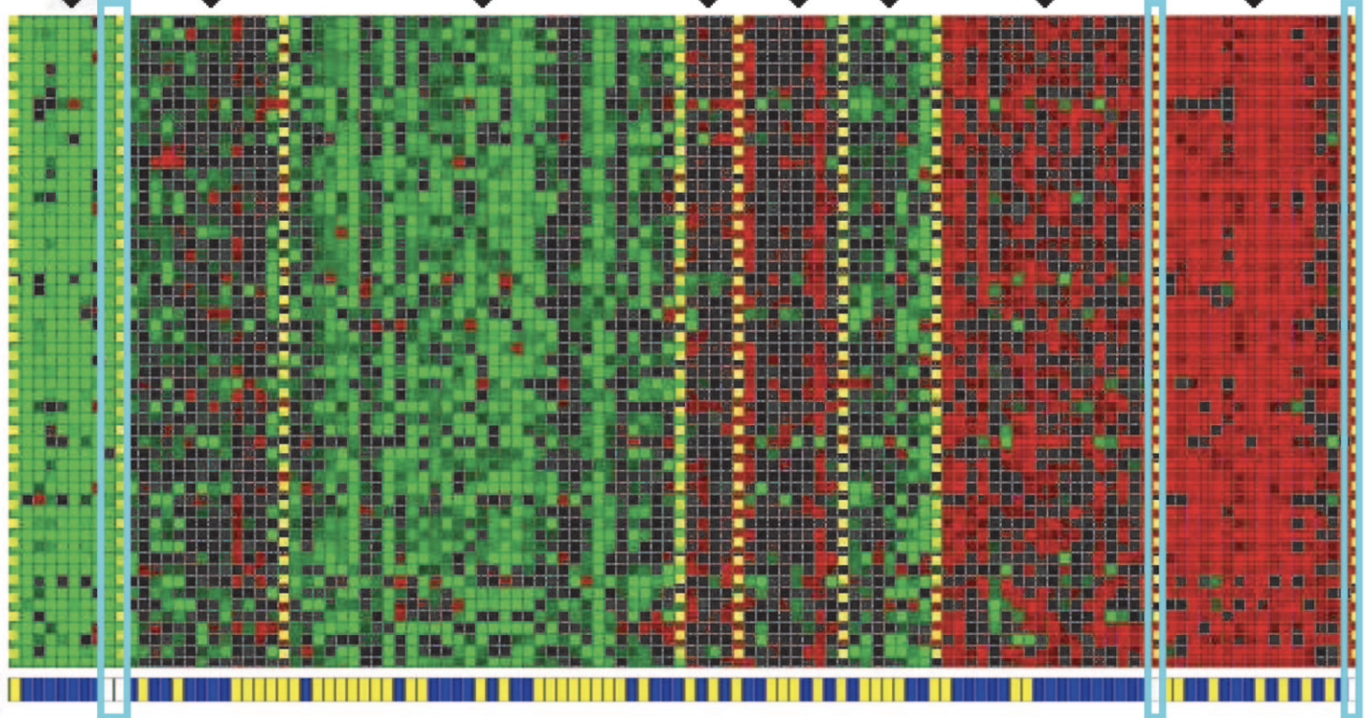
Cluster 1
Cluster 7
Genes
Individuals
Identifying Regulatory Mechanisms using Individual Variation Reveals Key Role for Chromatin Modification. [Su-In Lee, Dana Pe'er, Aimee M. Dudley, George M. Church and Daphne Koller. ’06]

Slide 18
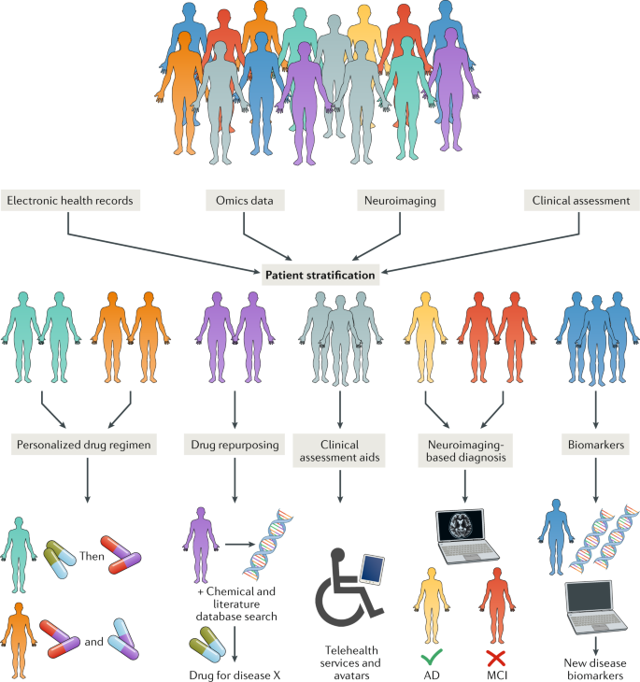

Slide 20
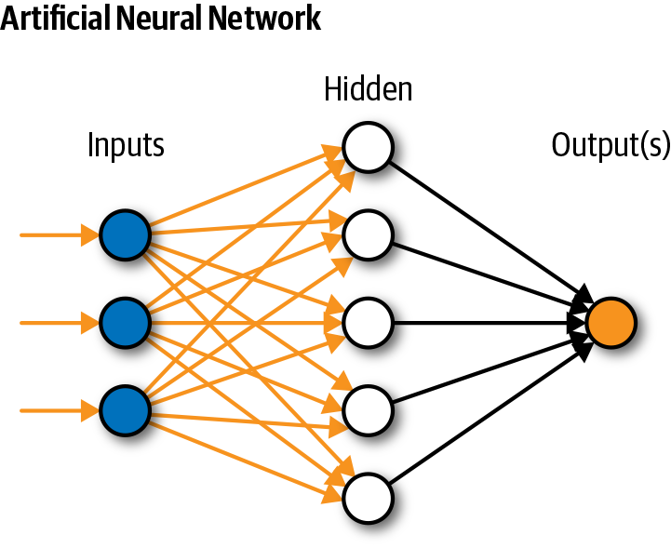
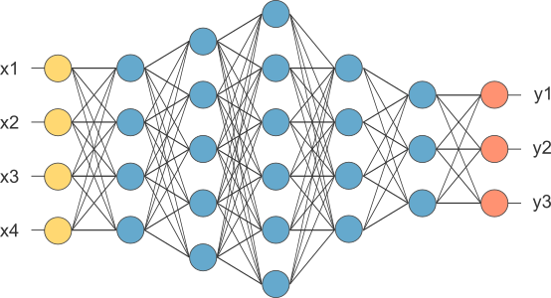

Slide 21
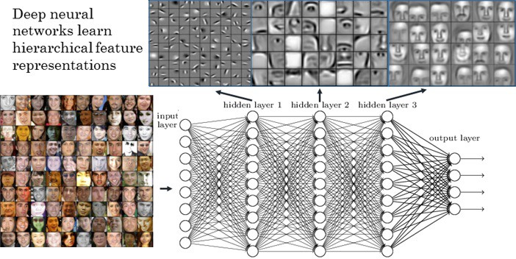

Slide 22
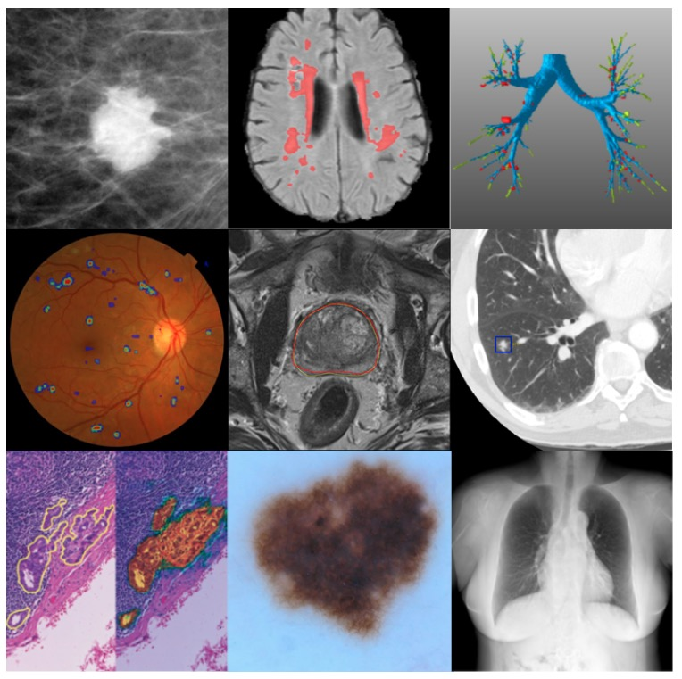
Notes:
Collage of some medical imaging applications in which deep learning has achieved state-of-the-art results. From top-left to bottom-right: mammographic mass classification (Kooi et al. (2016)), segmentation of lesions in the brain (top ranking in BRATS, ISLES and MRBrains challenges, image from Ghafoorian et al. (2016b), leak detection in airway tree segmentation (Charbonnier et al. (2017)), diabetic retinopathy classification (Kaggle Diabetic Retinopathy challenge 2015, image from van Grinsven et al. (2016)), prostate segmentation (top rank in PROMISE12 challenge), nodule classification (top ranking in LUNA16 challenge), breast cancer metastases detection in lymph nodes (top ranking and human expert performance in CAMELYON16), human expert performance in skin lesion classification (Esteva et al. (2017)), and state-of-the-art bone suppression in x-rays (image from Yang et al. (2016c)).

